Slide 1

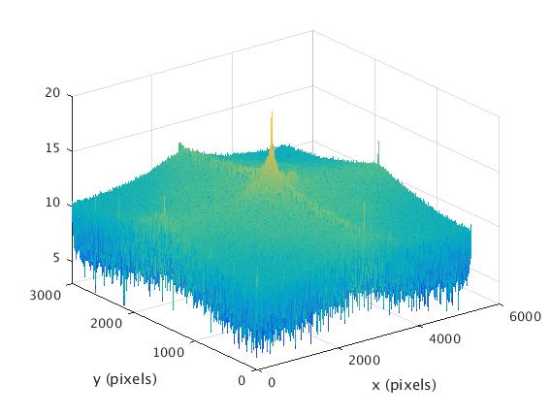
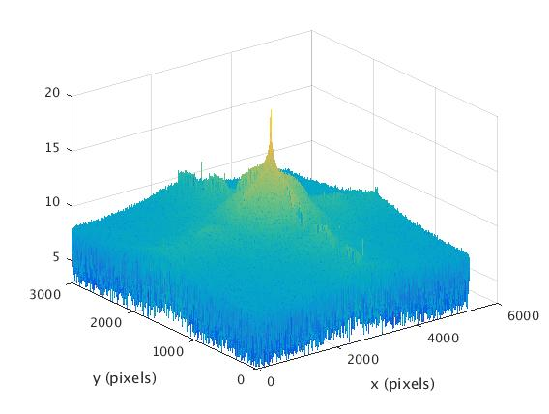
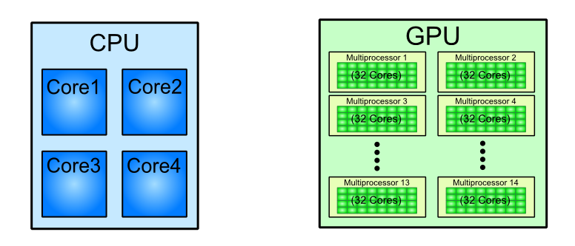
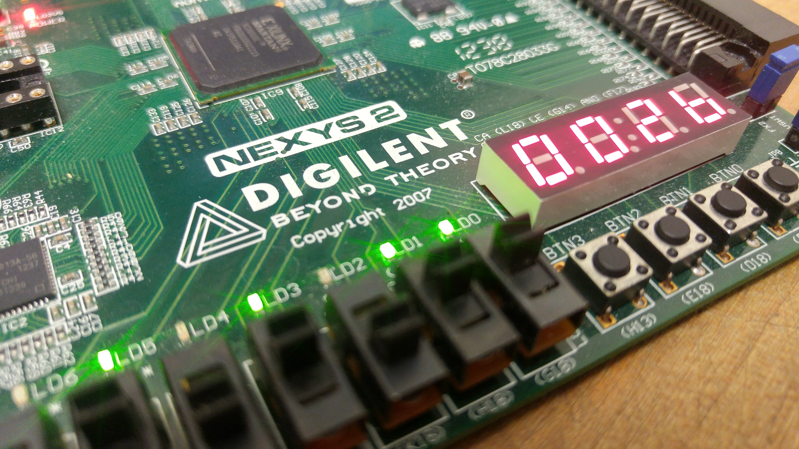
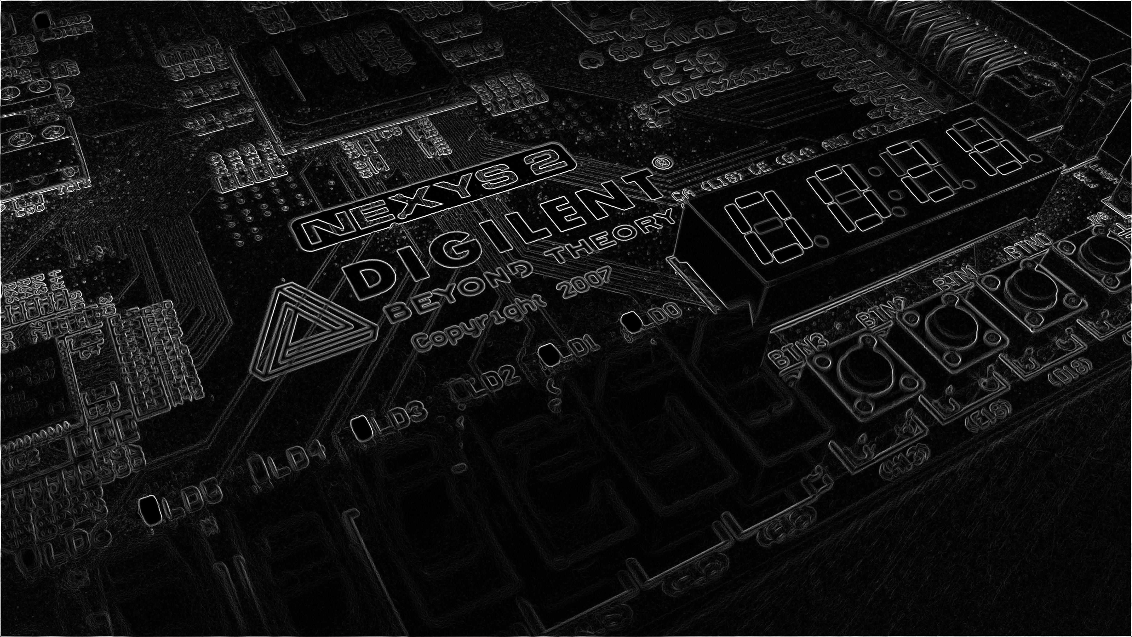
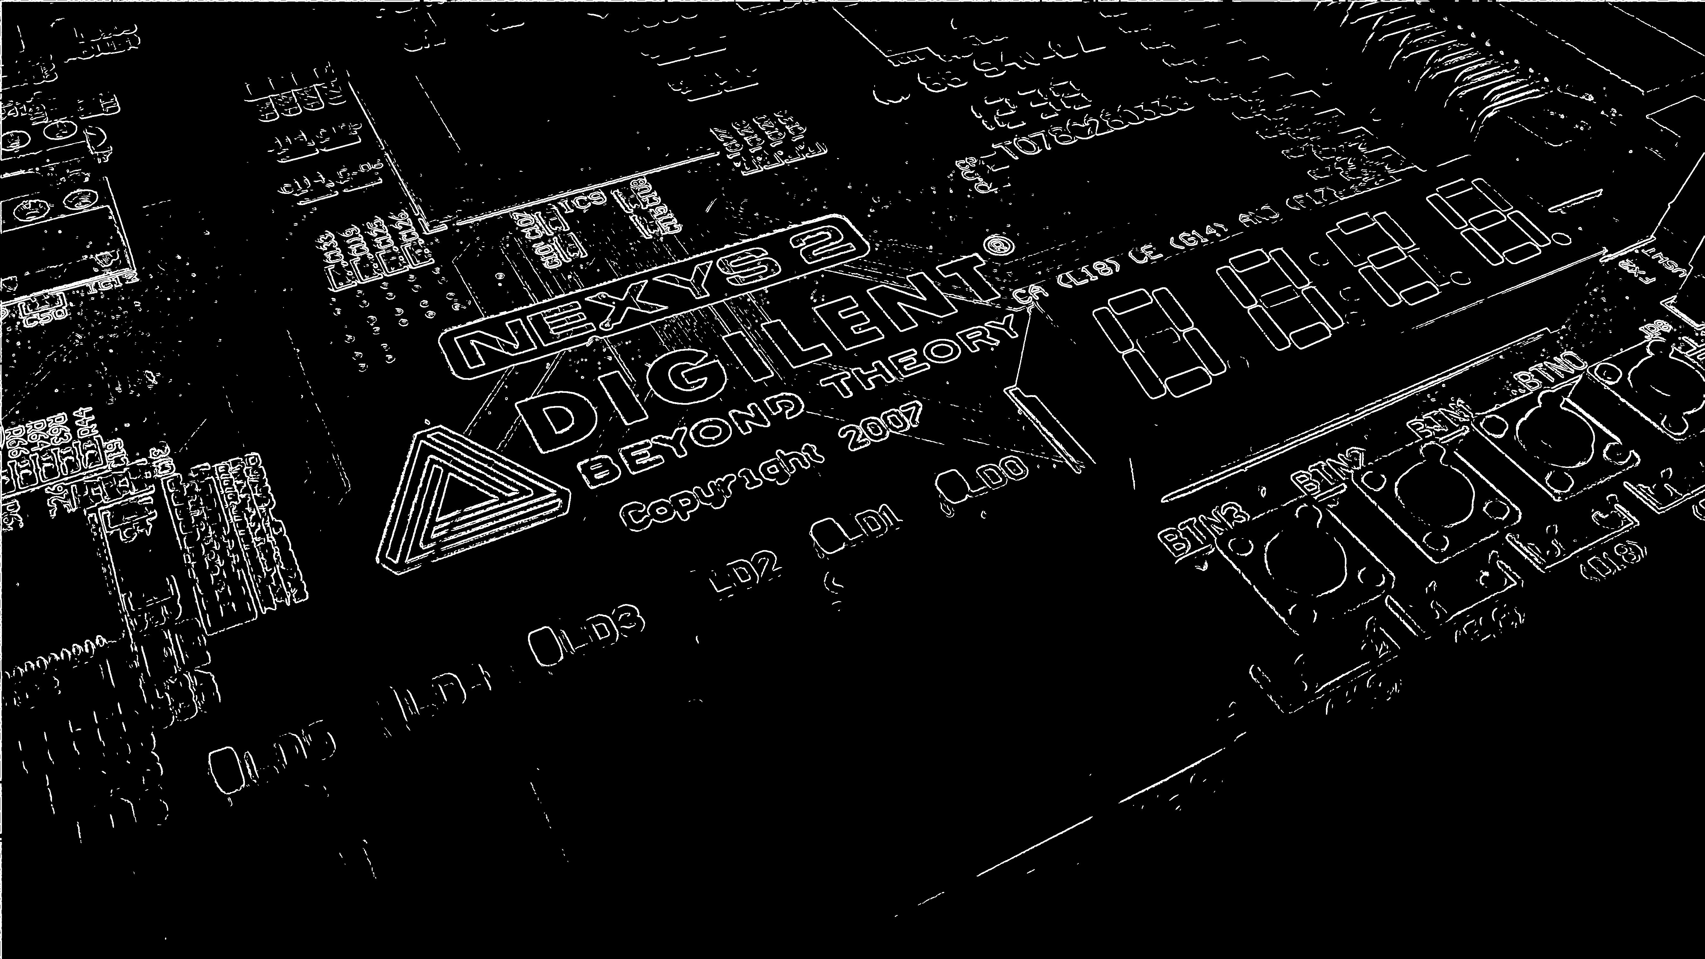
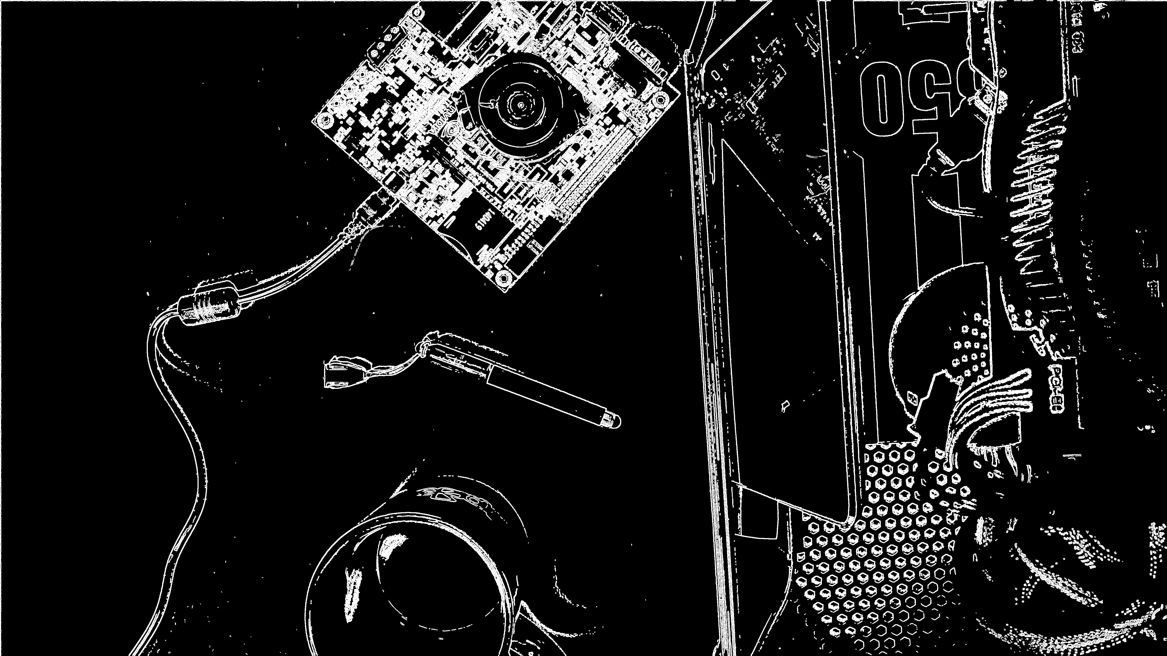

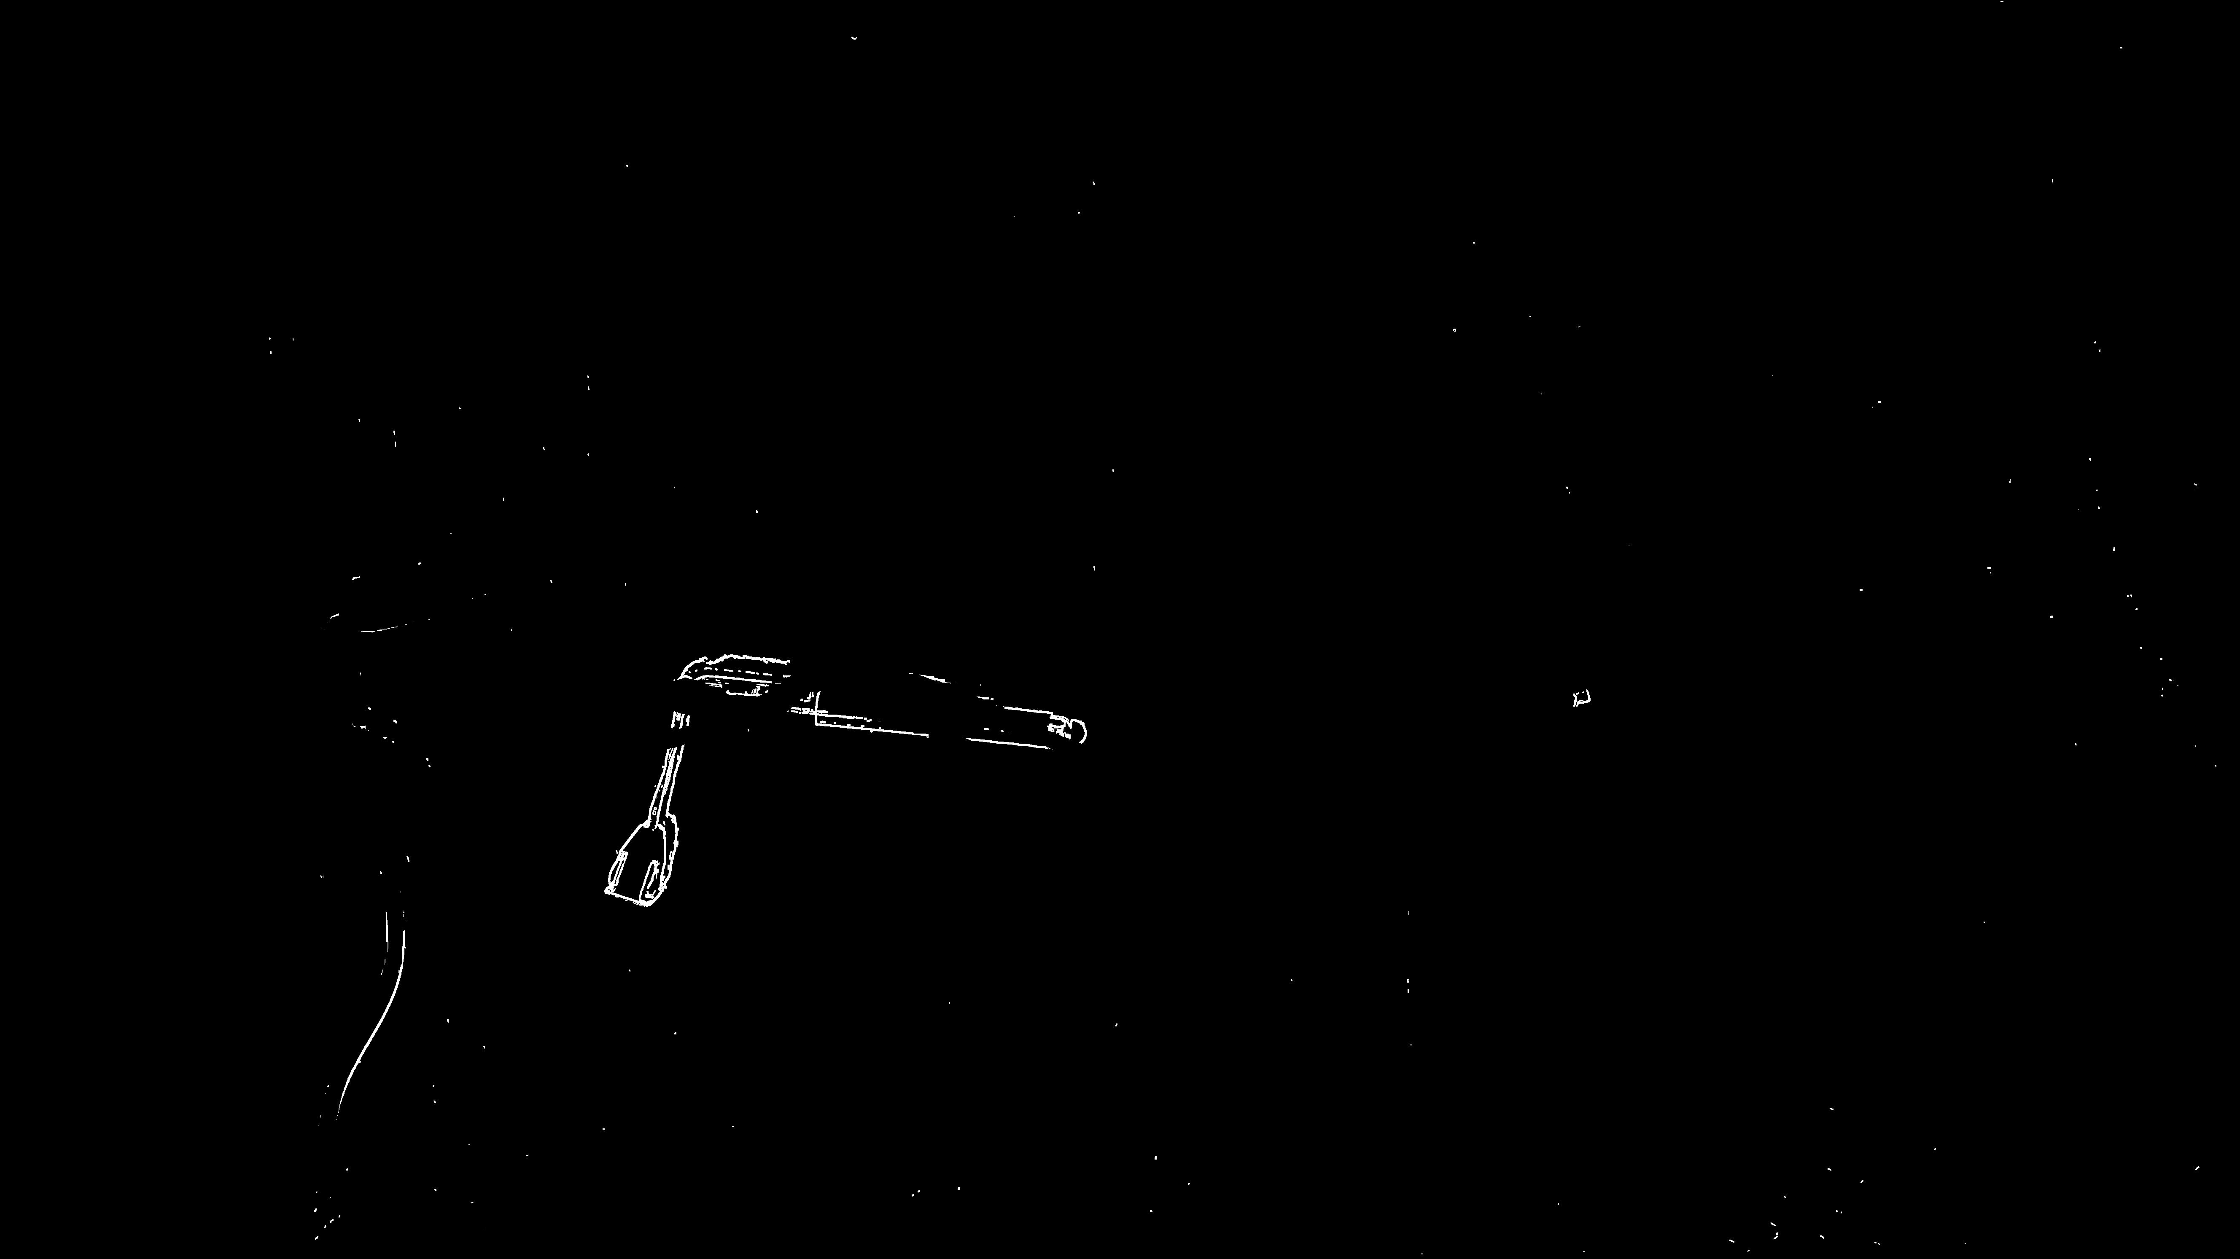
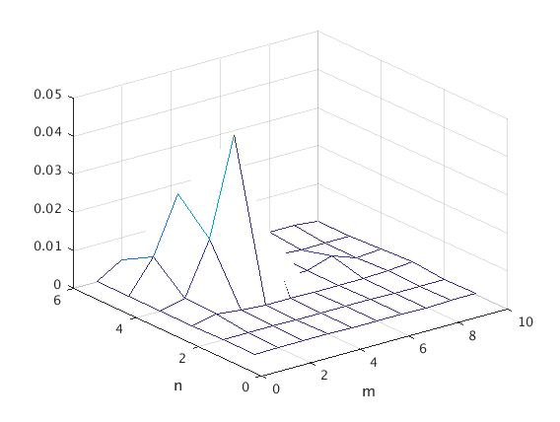

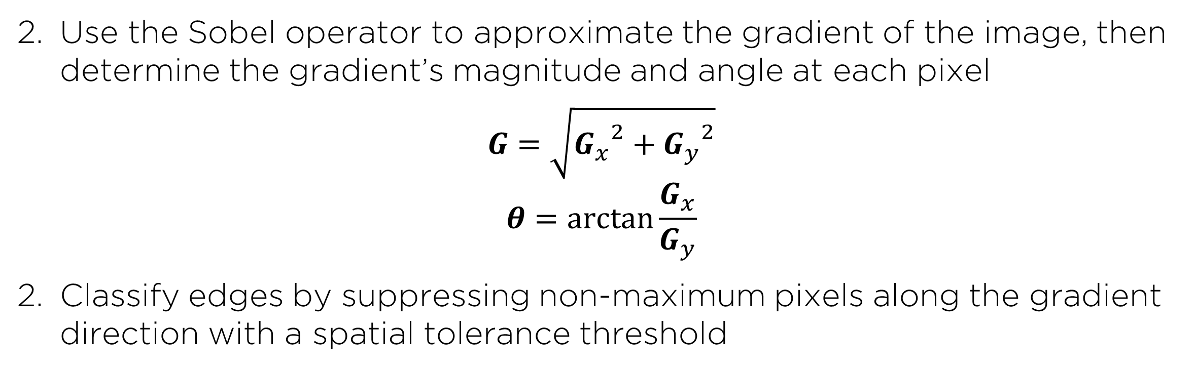
GPU-Accelerated Parallelization of
Common Computer Vision Applications
Department of Electrical and Computer Engineering, Rice University, Houston, TX
Emilio Del Vecchio, Kevin Lin, Senthil S. Natarajan
I. INTRODUCTION
III. EDGE DETECTION
V. GPU SPEEDUP RESULTS
-Graphics Processing Units (GPU’s) have recently become popular for their ability to parallelize computations and achieve much greater efficiency as compared to the serial implementation of a CPU.
Reduce high frequency noise from the image with a Gaussian blur
VS
Fig 1. The GPU’s parallel architecture allows it to parallelize massive computations.
Fig 2. FFT of grayscale noisy image, unfiltered (left) versus filtered (right)
Use the Sobel operator to approximate the gradient of the image, then determine the gradient’s magnitude and angle at each pixel
$$G=\sqrt{{G_{x}}^{2}+{G_{y}}^{2}}$$
$$θ=\arctan{\frac{G_{x}}{G_{y}}}$$
Classify edges by suppressing non-maximum pixels along the gradient direction with a spatial tolerance threshold
-Our objective: utilize the GPU’s ability to accelerate computer vision applications like facial recognition, edge detection, and motion tracking.
-Due to the proliferation of computer vision in many regular tasks, this affords us an opportunity to explore how to make such common algorithms more efficient.
II. ML FACIAL RECOGNITION
Fig 3. Original image (left), Sobel filter output (center), final edges (right)
IV. MOTION DETECTION
VI. CONCLUSIONS
Calculate a pixel-by-pixel difference map from the edges of two frames, applying movement tolerance thresholding in the process
-HAAR cascade classifiers turn up a relatively high rate of false positives in facial recognition. (next -> HOG)
Fig 4. Two sequential frames in a video stream and the detected difference between them
Estimate the motion region from a difference density map
Fig 5. Spatial density map (left), motion area estimation (right)

